Slide 1
Car Accident Severity Presentation
By Turana Gasimli

Slide 2
Introduction
We will be using Machine Learning algorithms to predict the severity of car accidents in Seattle with certain conditions concerning the environment – weather, road conditions, light conditions etc.
This will help to take precautions to lower the number of accidents in the future, and to locate them easily and quicker.
We must first clean our data and extract the necessary information.

Slide 3
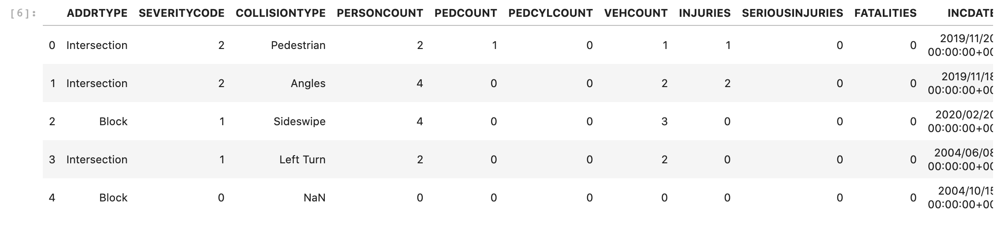
Data Understanding
The data displays several independent variables, such as the weather, road condition, light condition.
The dependent variable, or the target, is the severity code.

Slide 4
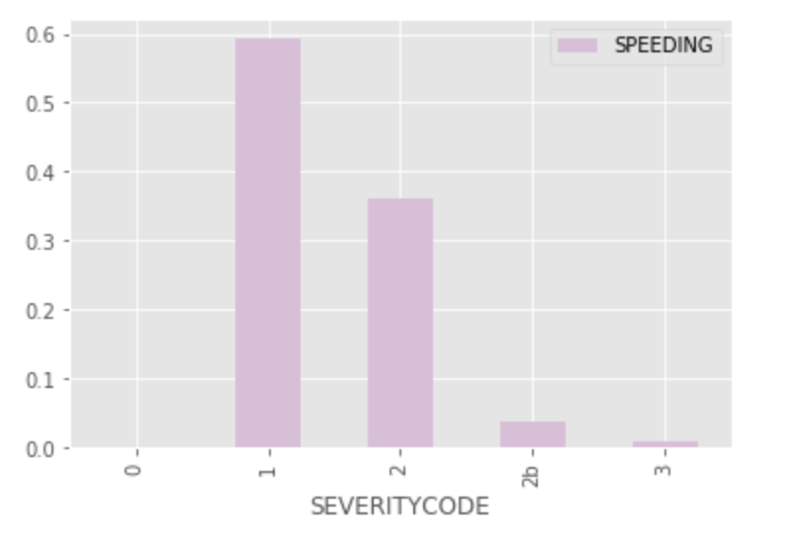
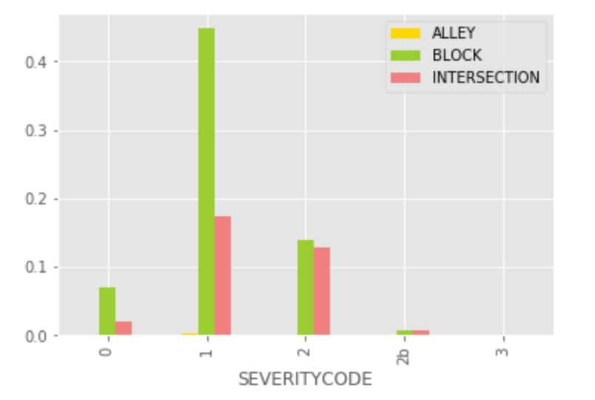
Data visualization – not in direct relation with the collision

Slide 5
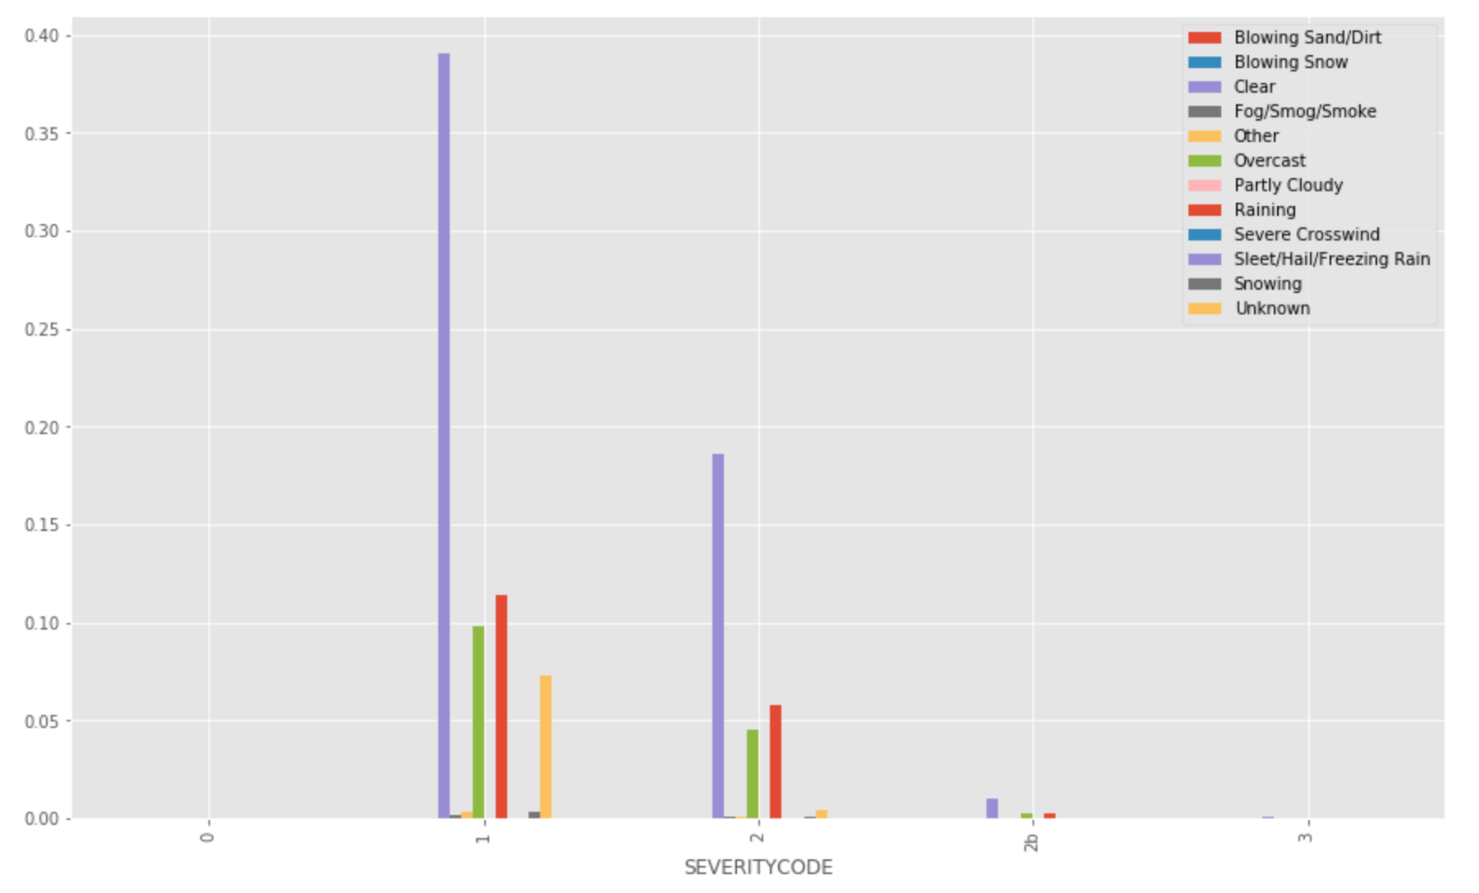
Data visualization - Weather

Slide 6
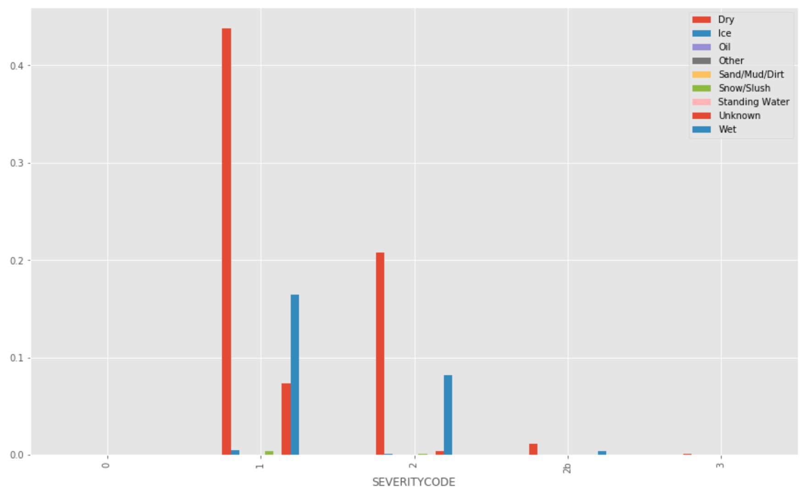
Data visualization – road condition

Slide 7
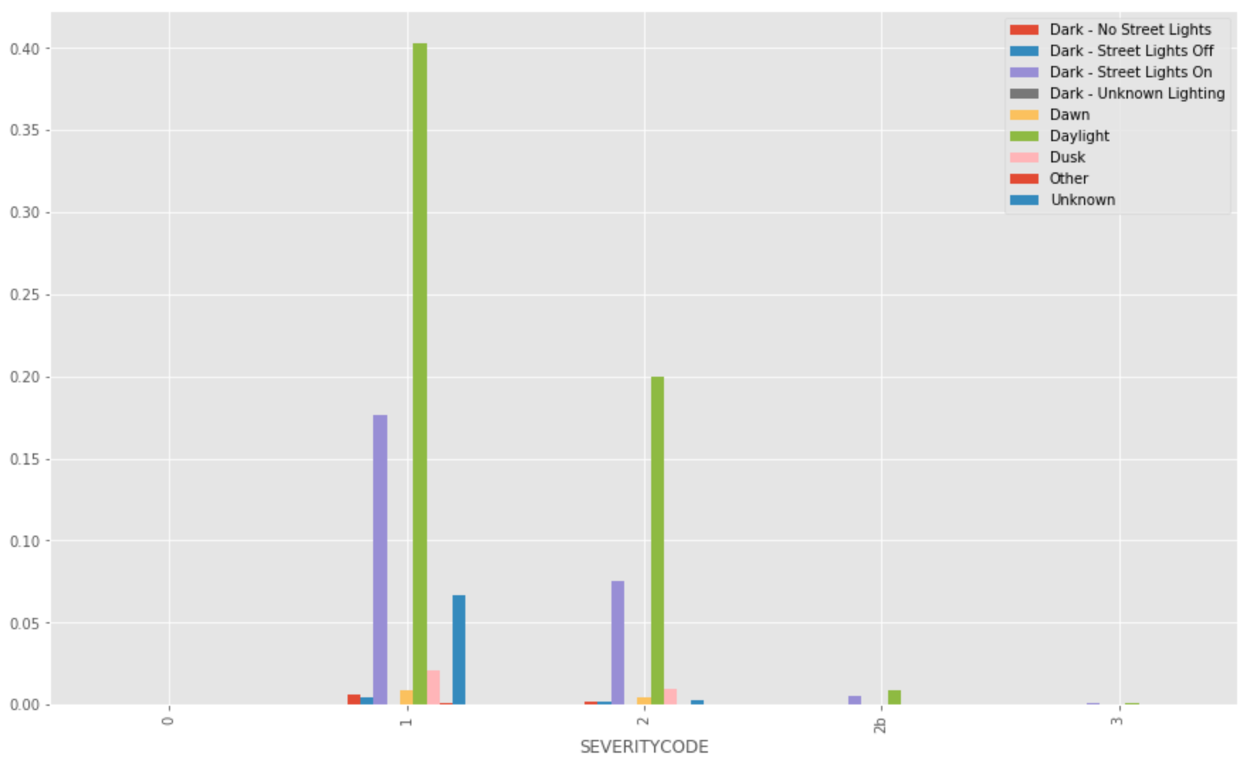
Data visualization – light condition

Slide 8
Conclusion
Machine learning algorithms have helped us graph out the columns and get a visual representation of how accidents have occurred in the past, thus helping us anticipate what to expect, and hence prevent any further accidents from happening. Although it's impossible to prevent car accidents from happening entirely; it still helps to locate the hot-spots for most accidents and start taking precautions from there in accordance with our visual aid we have created in this project.

